Slide 2
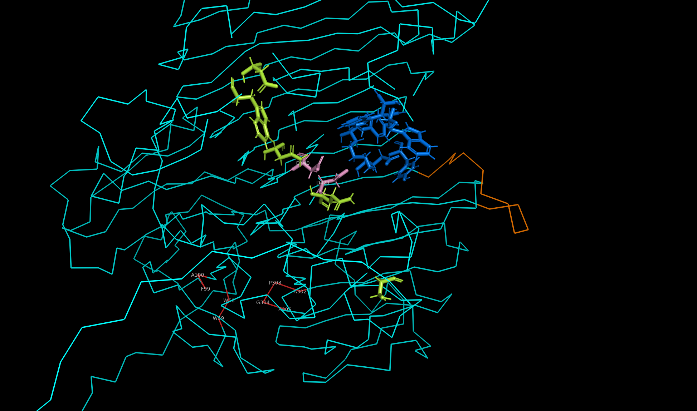

Slide 3
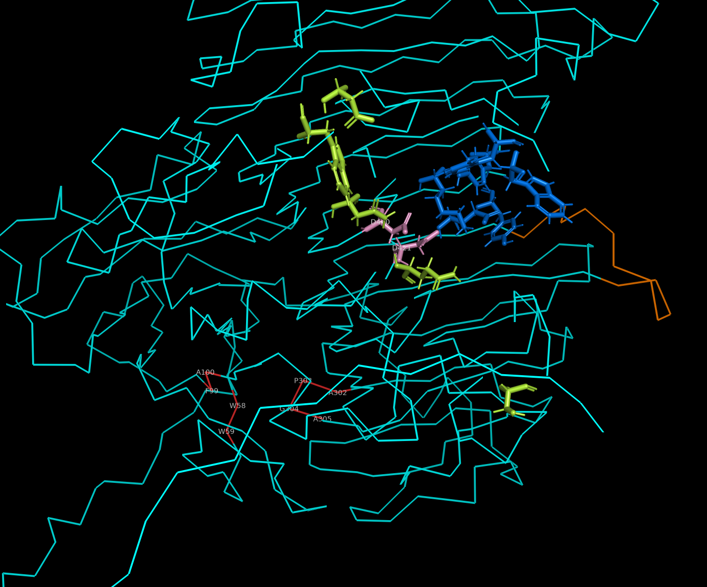
Positive sites
Negative sites
Catalytic center
Loop
GO:0004553
Hydrolyase
Activity

Slide 4
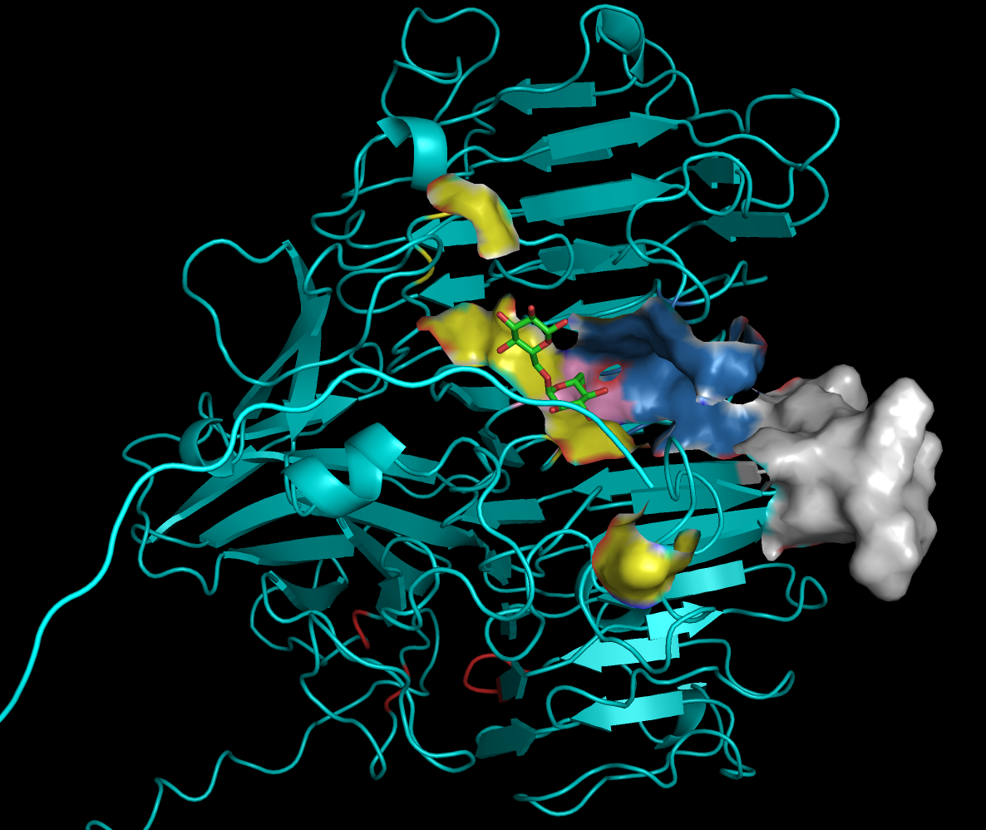

Slide 5
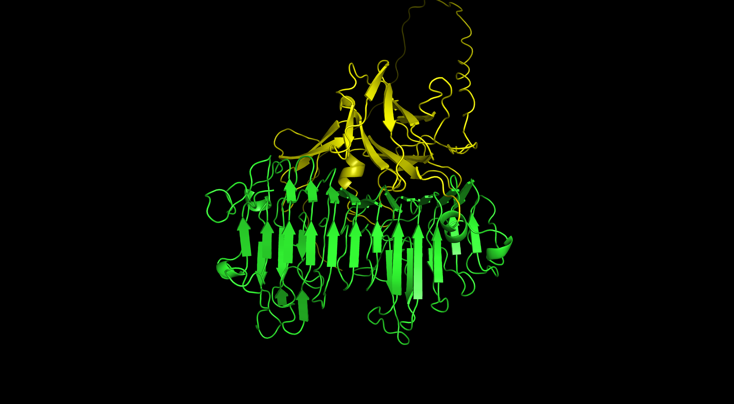
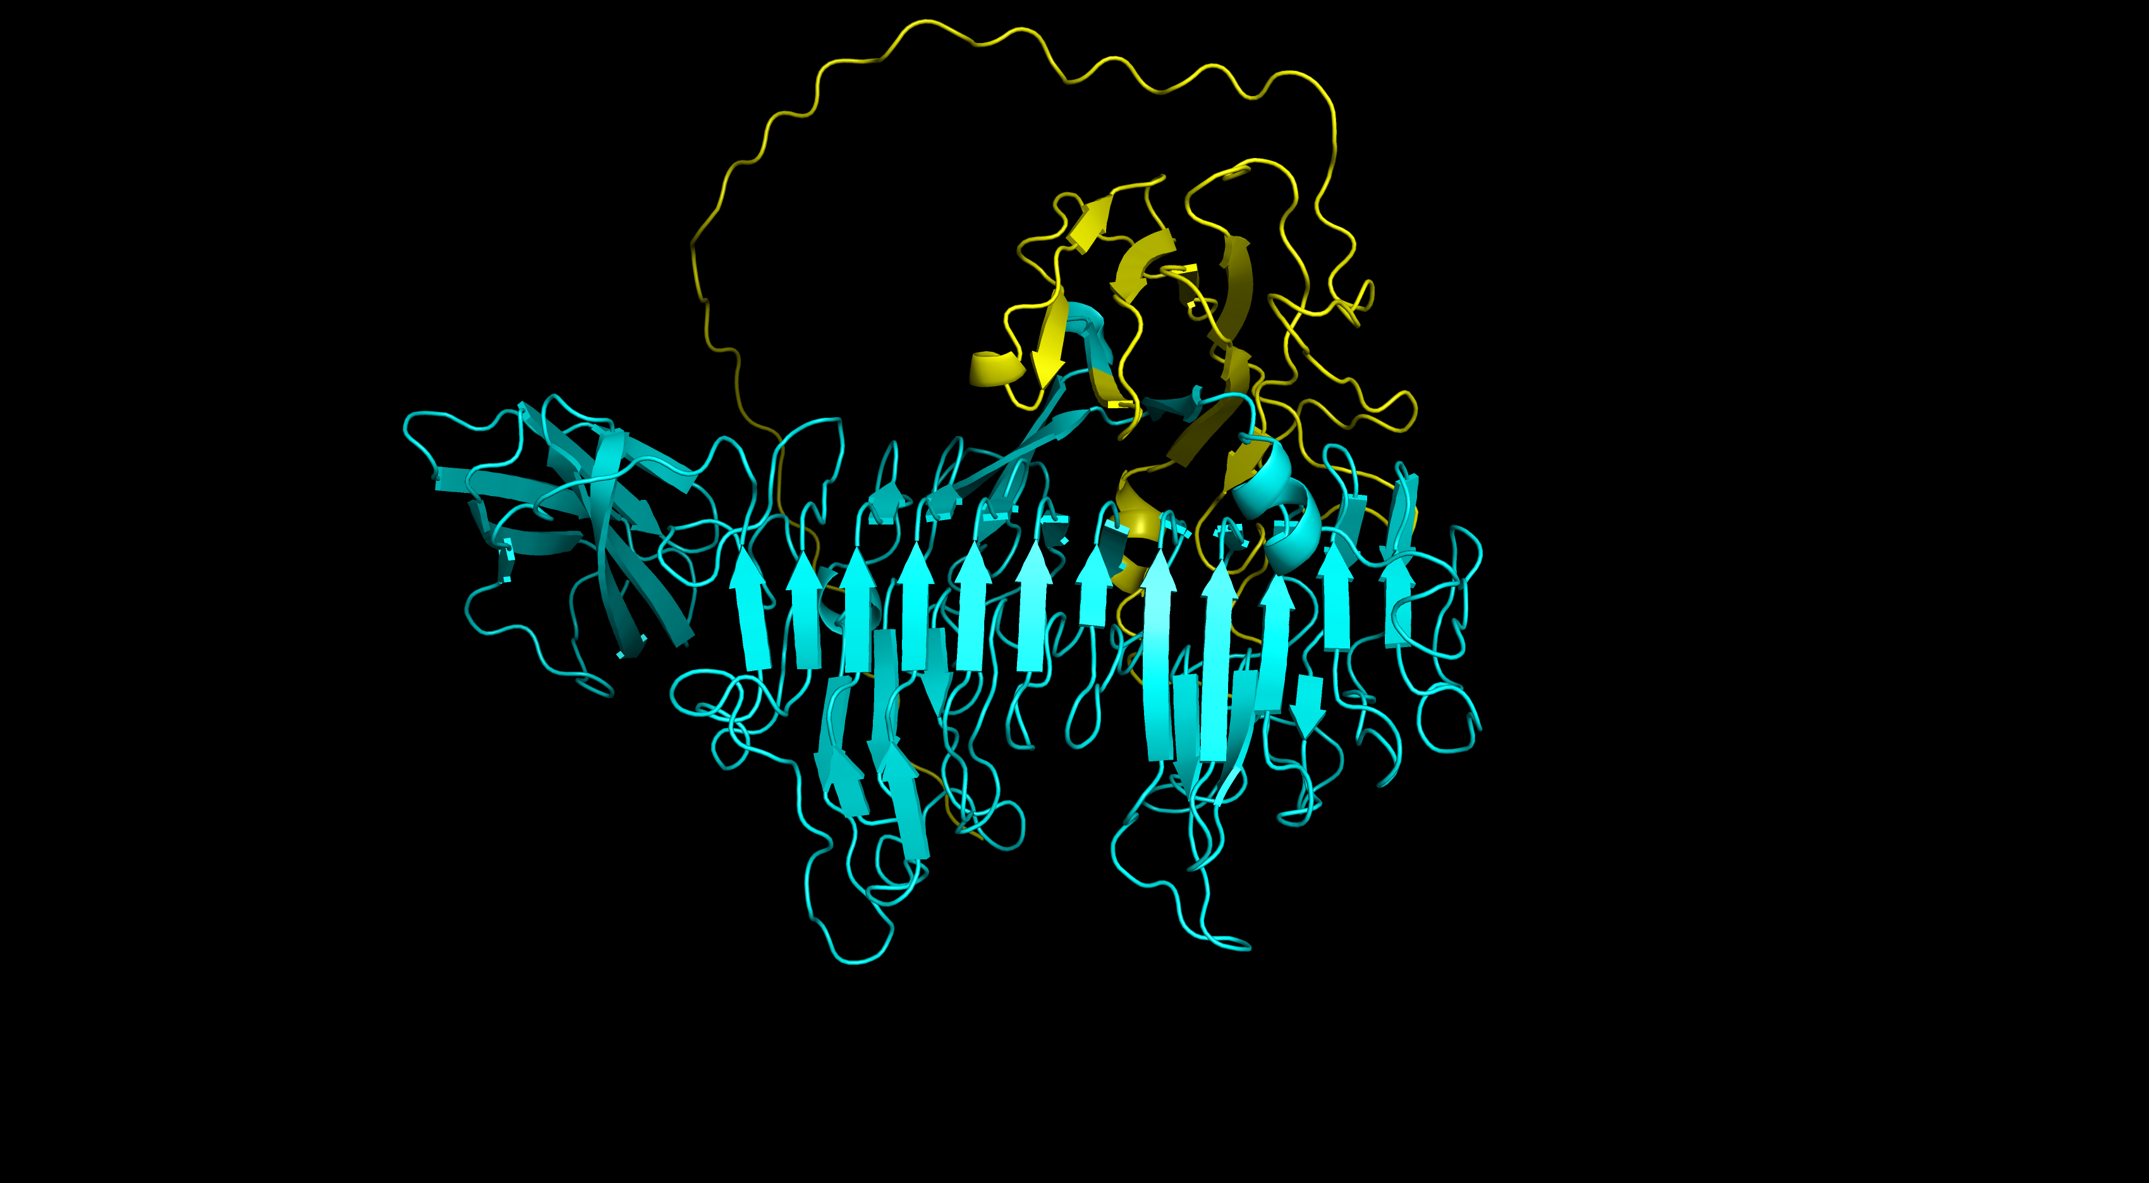

Slide 6
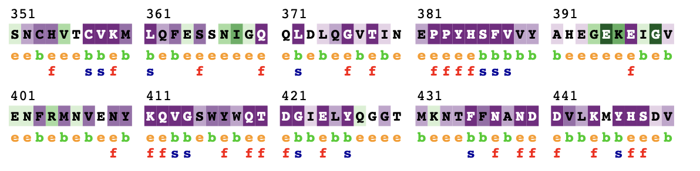
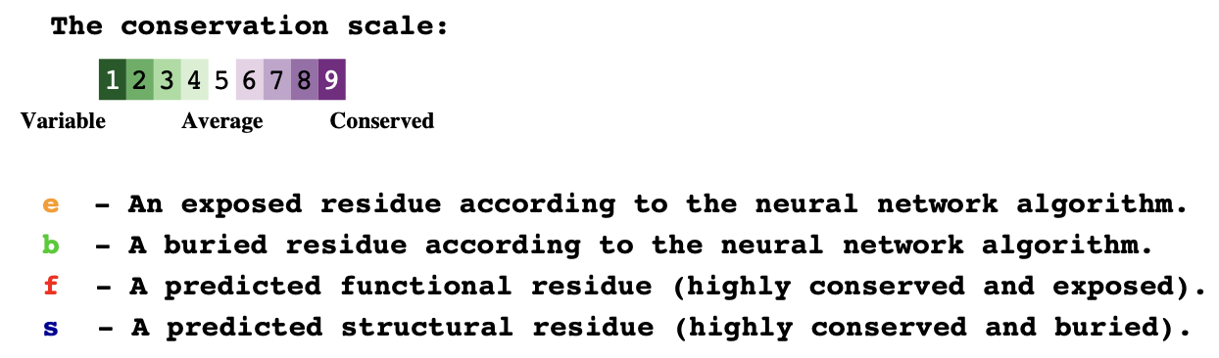
BfIMTD
loop

Slide 7
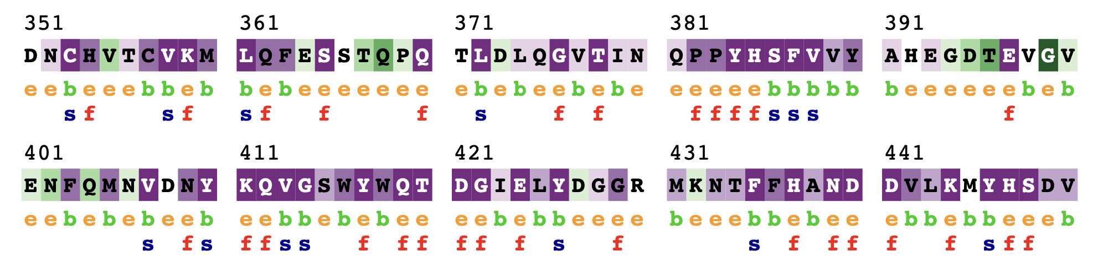
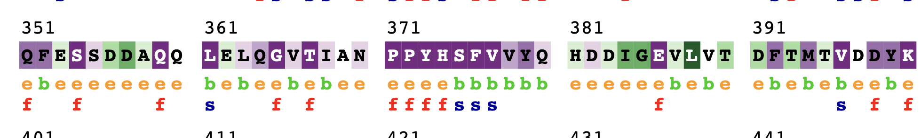
CcDex
loop
MrDex
loop

Slide 8
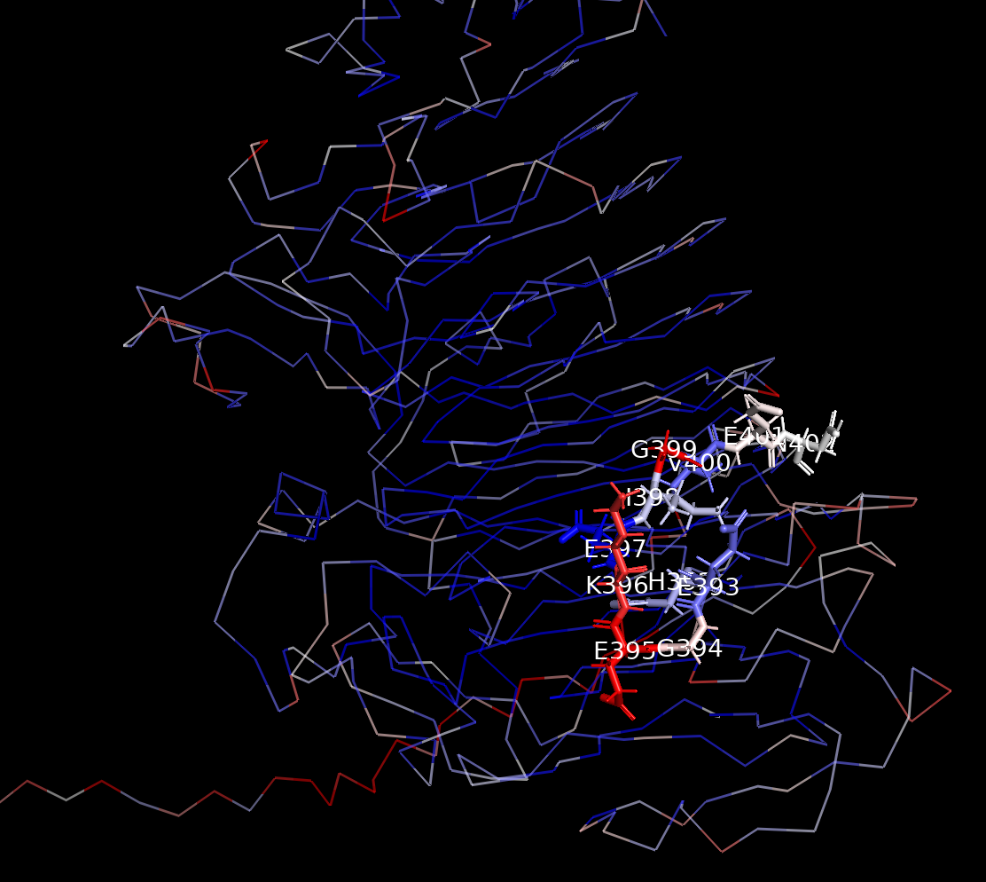
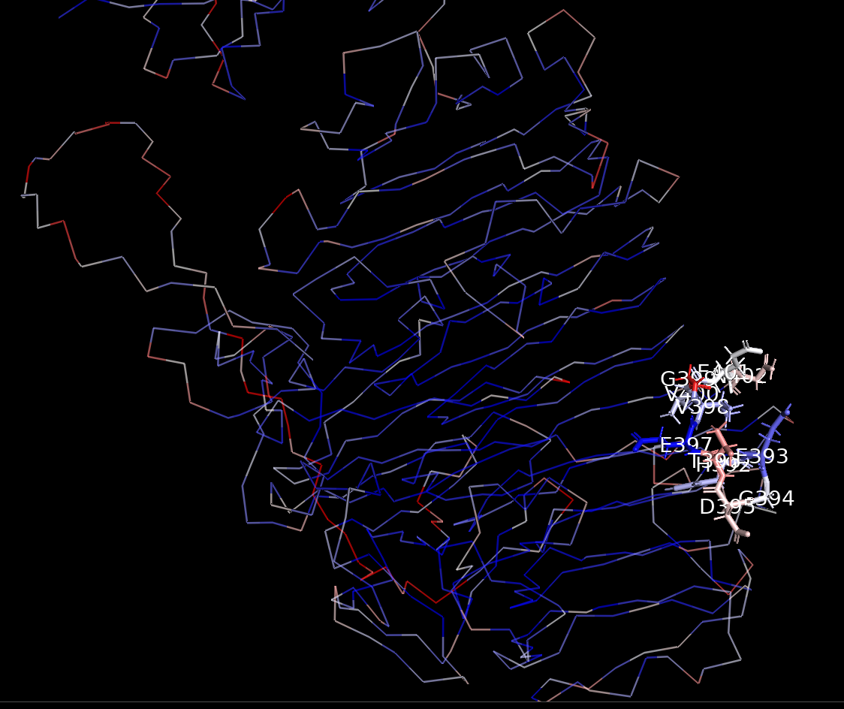
BfIMTD
CcDex

Slide 9
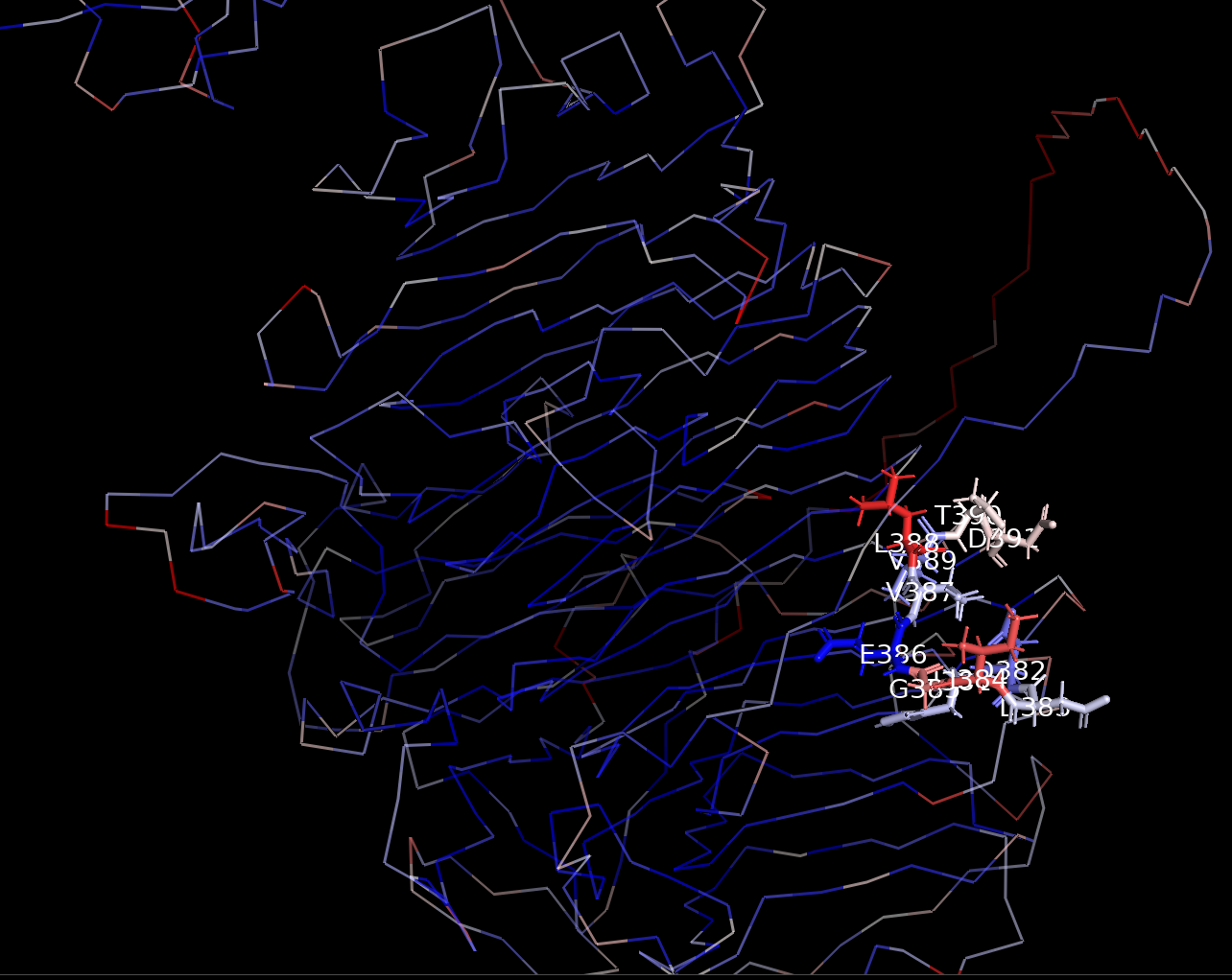
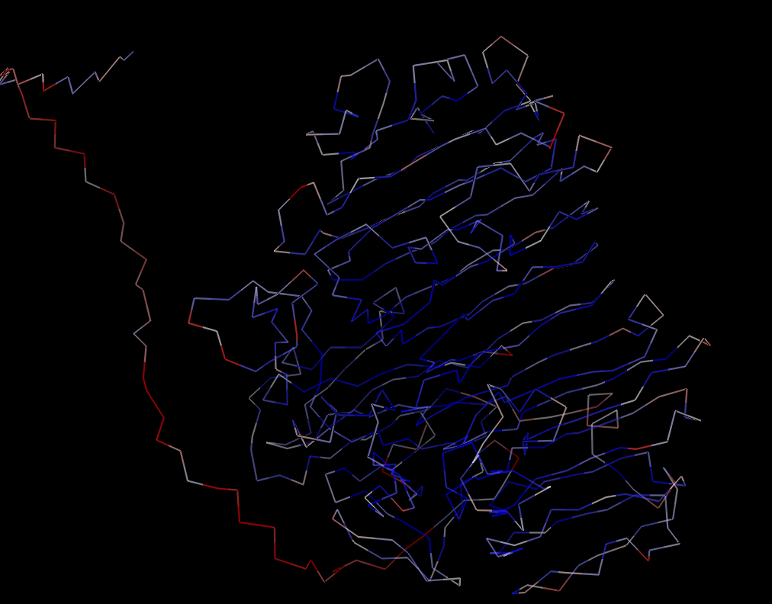
MrDex
DexKQ

Slide 10
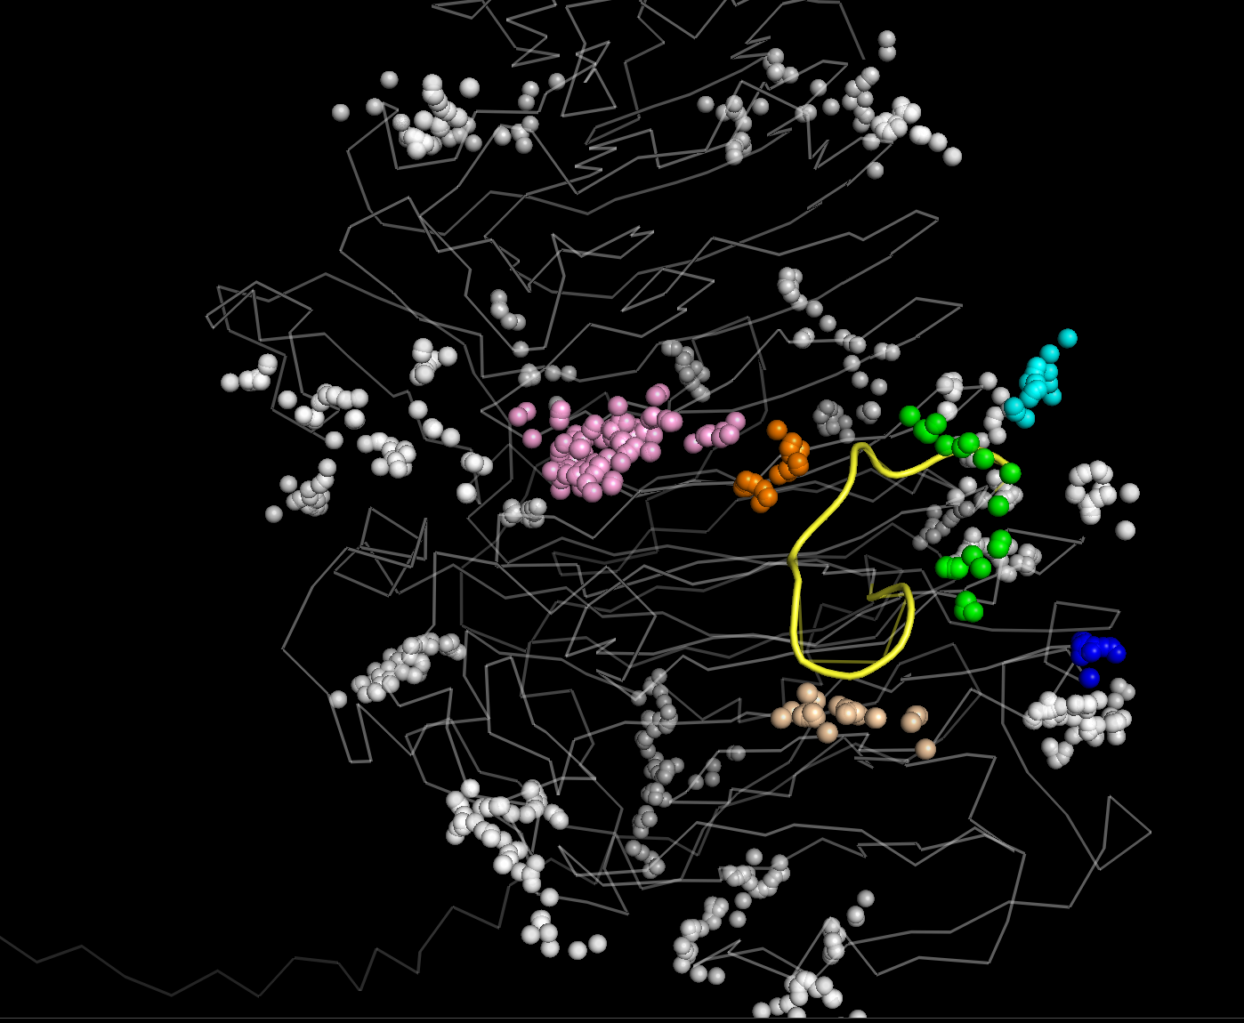
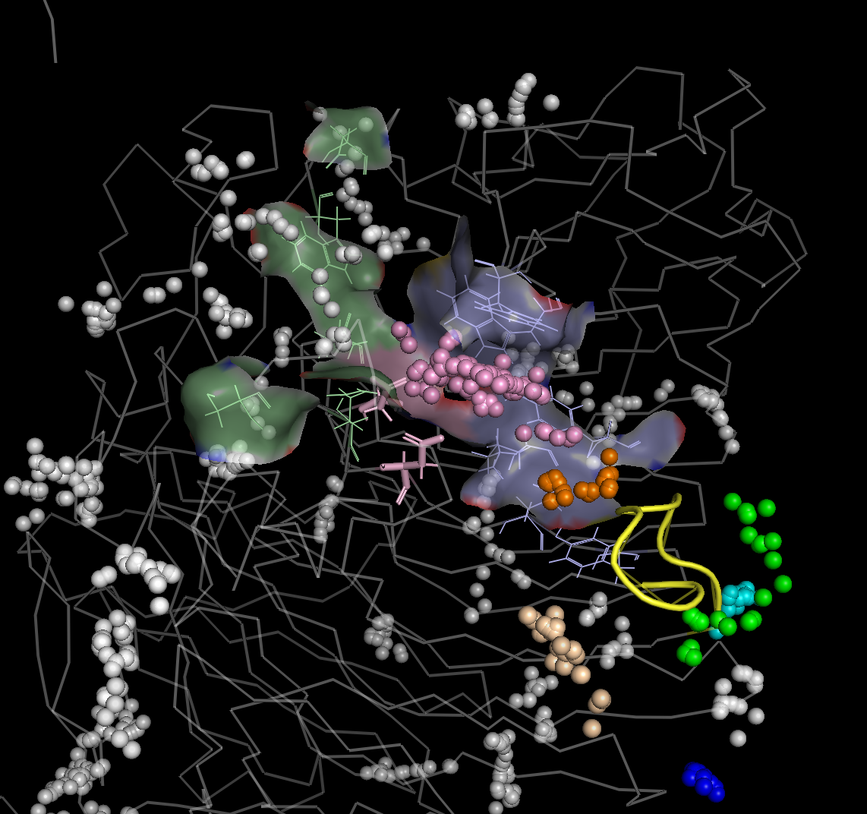
BfIMTD
BfIMTD
Pocket 7
Positive sites
Pocket 28
Pocket 29
Negative sites
Pocket 29
Pocket 4
loop
Pocket 28
Catalytic residues
D440 D421
Pocket 31
Pocket 32
loop

Slide 11
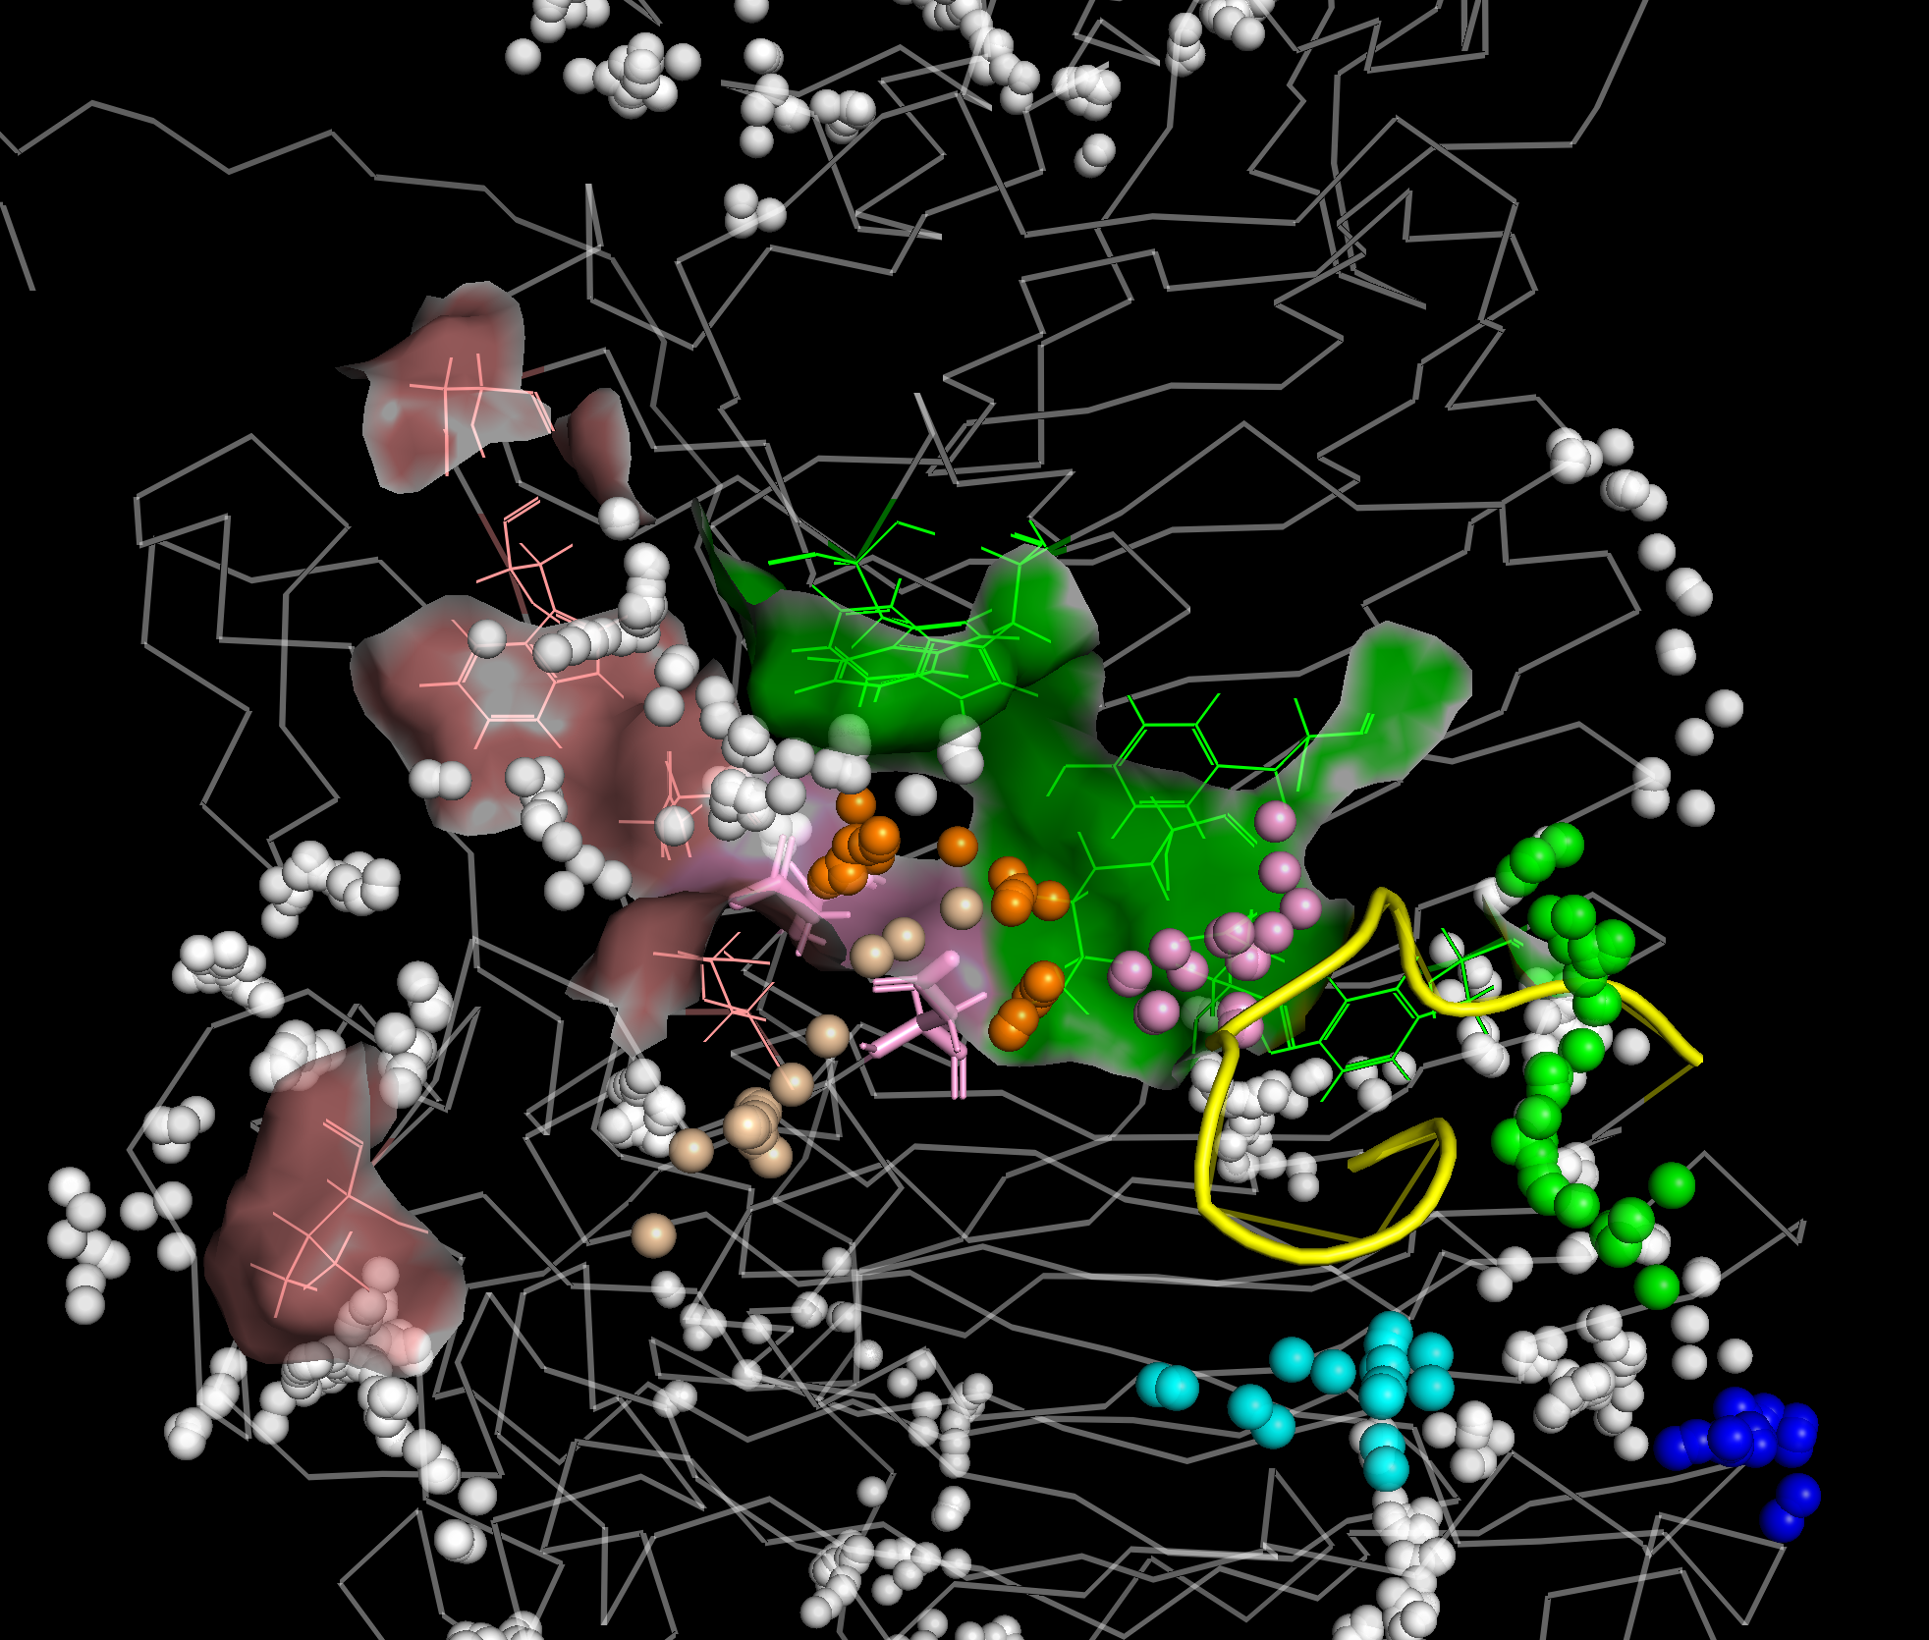
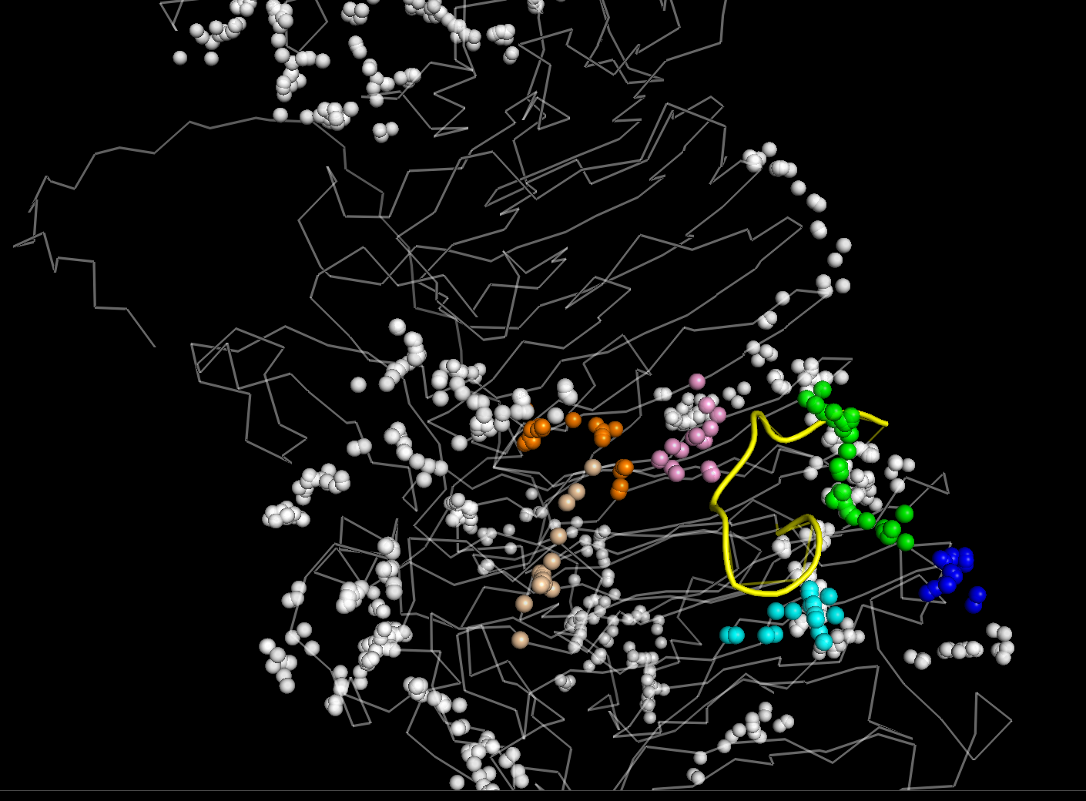
CcDex
CcDex
Negative sites
Positive sites
Pocket 18
Pocket 33
Pocket 32
Pocket 18
Pocket 33
Pocket 17
loop
Catalytic residues
D440 D421
loop
Pocket 31
Pocket 23

Slide 12
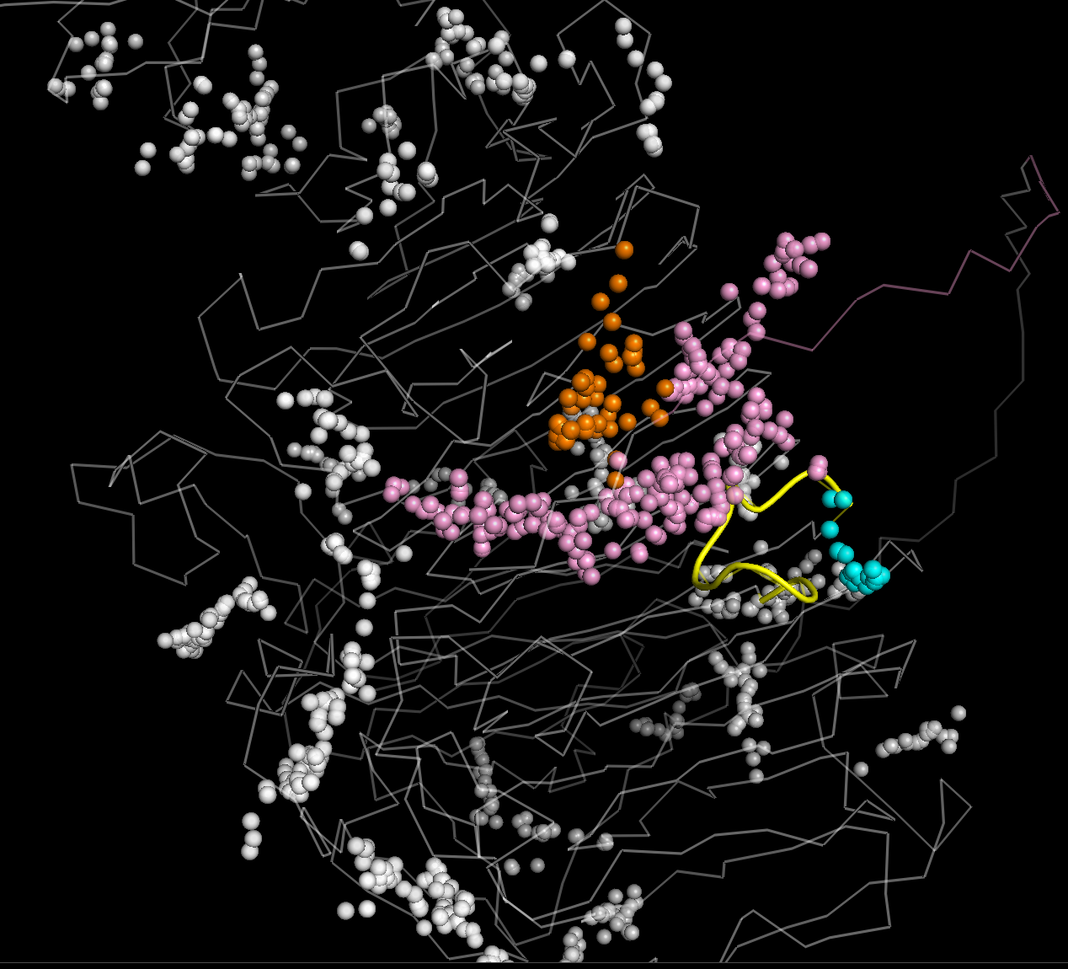
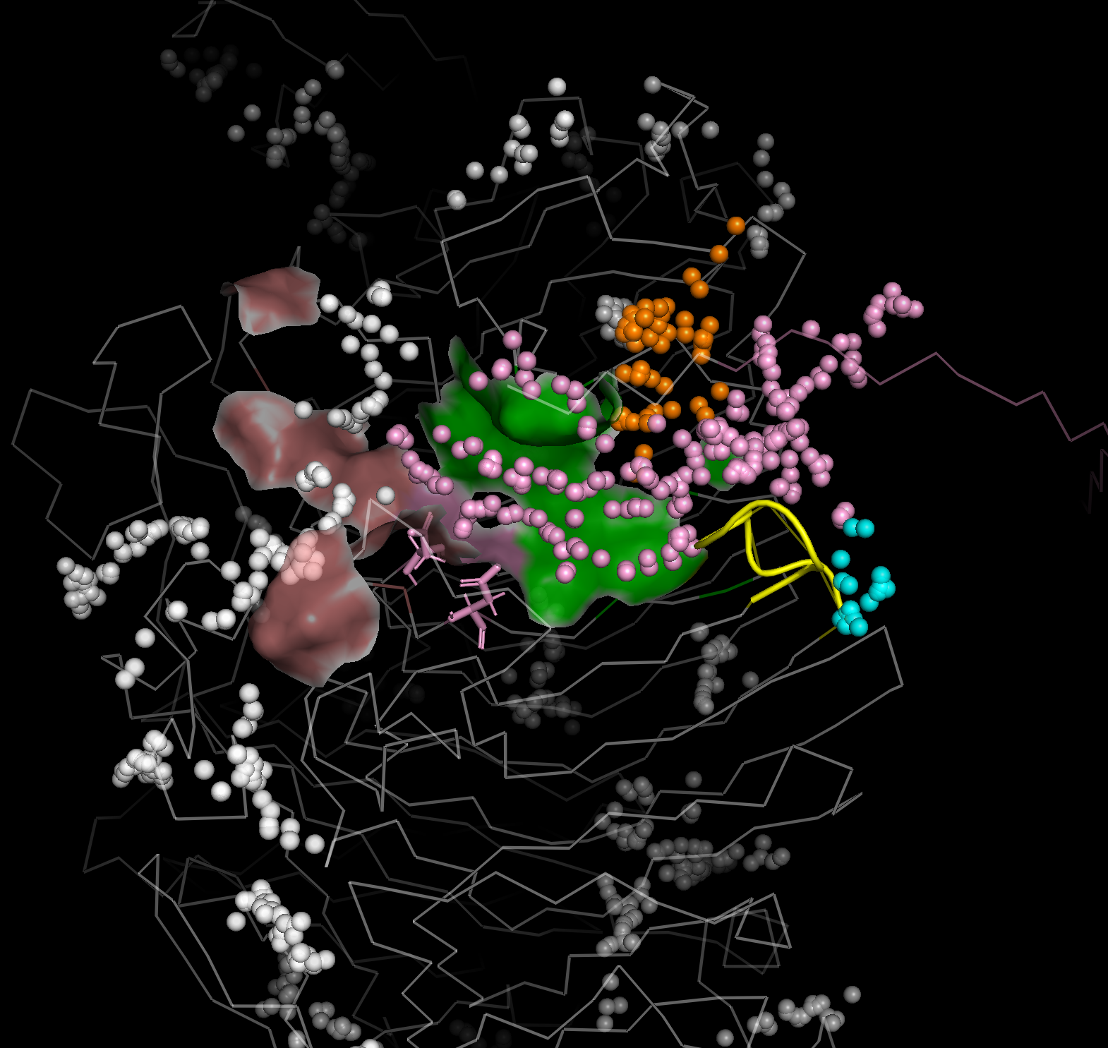
MrDex
MrDex
Pocket 32
Pocket 32
Negative sites
Positive sites
Pocket 33
loop
loop
Pocket 33
Pocket 19
Catalytic residues
D410 D429

